Slide 1
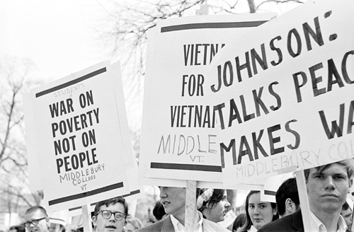
Opposition to the Vietnam War 22-3

Slide 2
Terms and People
draftee − a young man who was drafted into military service
Students for a Democratic Society (SDS) − organization founded to fight racism but which later campaigned against the Vietnam War
“credibility gap” − the American public’s growing distrust of statements made by the government during the Vietnam War

Slide 3
Terms and People (continued)
Tet Offensive − a coordinated assault, in January 1968, by the Vietcong and North Vietnamese on South Vietnamese cities and bases
Eugene McCarthy − the antiwar candidate for the Democratic Party presidential nomination in 1968
Robert Kennedy − New York’s Democratic senator and a candidate for the Democratic Party presidential nomination in 1968

Slide 4
By 1965 most of the troops sent to Vietnam were no longer volunteers, they were draftees.
Many people opposed the policies of the draft.
More than 1.5 million young men were drafted during the Vietnam War.
Many argued that the draft unfairly gave deferments to students.
Most of the draftees came from a poor or working-class background.

Slide 5
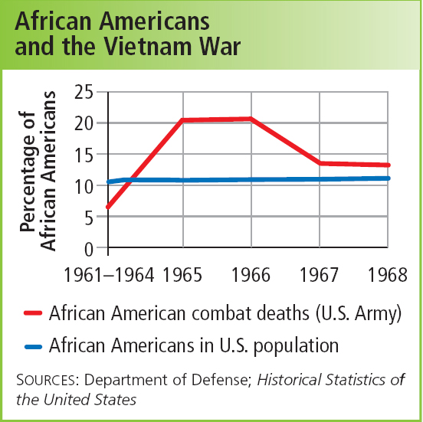
The number of African Americans fighting in Vietnam was disproportionately high.
African Americans were less likely than whites to become commissioned officers. They were more likely to serve, and die, in combat positions.

Slide 6
Inequalities in the draft led to widespread resistance against the war.
In 1969, the draft was restructured to introduce a lottery system.

Slide 7
Students’ opposition to the war grew.
Colleges and universities became centers of antiwar activism.
Most student protesters were from the middle class; working-class students were less likely to protest against the war.
Students for a Democratic Society (SDS) campaigned to end the war in Vietnam.

Slide 8
TV news showed the war’s horrors.
The difference between government reports and news stories created a credibility gap.
Beyond college campuses, more and more Americans also opposed the war.

Slide 9
In November 1967, General Westmoreland addressed the nation’s concerns about the war.
He claimed the Vietcong had weakened and could no longer mount a major attack.
However, in early 1968 the Vietcong and North Vietnamese launched the Tet Offensive.

Slide 10
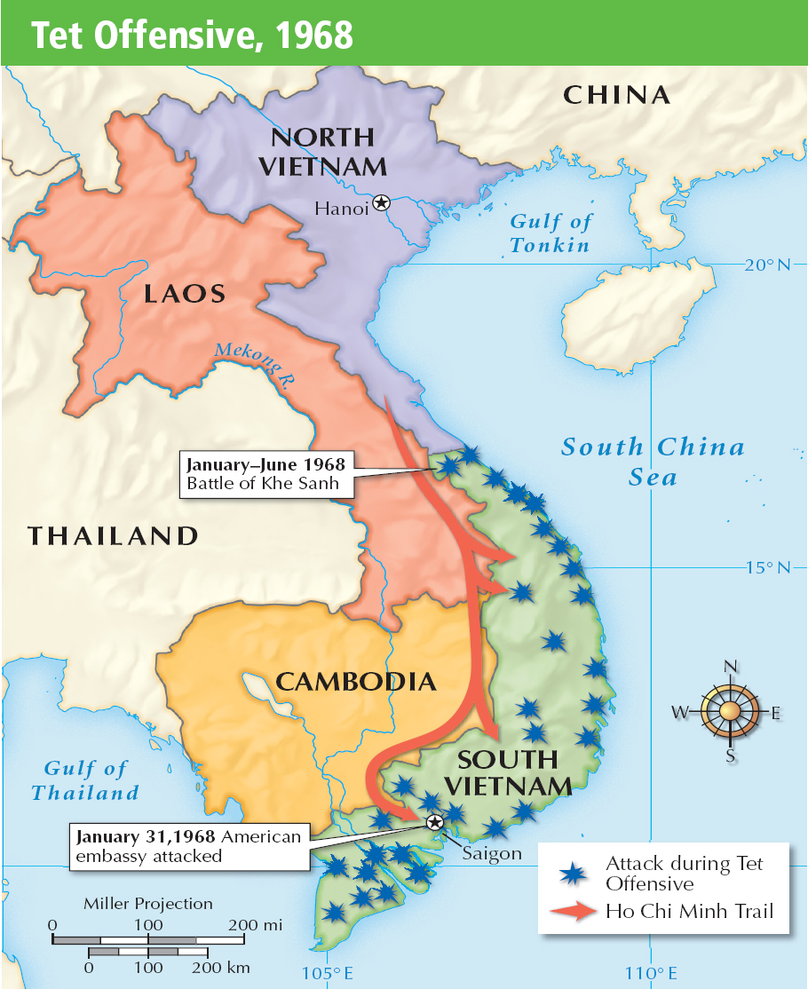
The Tet Offensive attacked major cities and bases in South Vietnam, including the U.S. Embassy in Saigon.
The fighting was fierce, but American and South Vietnamese forces eventually
drove back the offensive.

Slide 11
After the Tet Offensive, U.S. military leaders became less certain that the war could end quickly.
The new Secretary of Defense, Clark Clifford, recommended that President Johnson pursue peace, rather than victory, in Vietnam.

Slide 12
In 1968, Johnson shocked the nation by announcing that he would not run for another term as President.
Democratic Senator Eugene McCarthy, who opposed the war, made a strong showing in the New Hampshire primary.
Robert Kennedy, a Democratic Senator from New York, also announced his candidacy.

Slide 13
The optimism of the early 1968 campaigns ended as violence stunned the nation.
In April, Rev. Martin Luther King, Jr. was assassinated in Memphis.
Senator Robert Kennedy was assassinated in June, just after he’d won the California Democratic primary.
Police used rough tactics to break up student protests outside the Democratic Convention in Chicago.

Slide 14
Republicans held a more peaceful convention, choosing Richard M. Nixon as their presidential candidate.
Eventually the Democrats chose Hubert Humphrey, Johnson’s Vice President, as their presidential candidate.

Slide 15
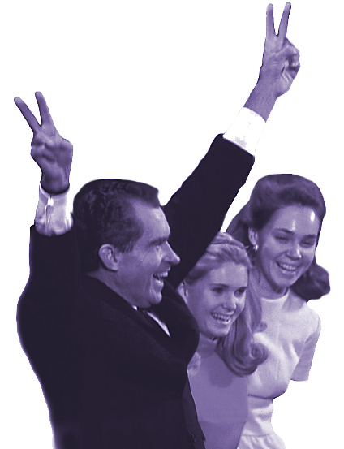
Nixon won the 1968 election.
He called for peace with honor in Vietnam.
He appealed to the “silent majority”—people who were not protesting.
He benefited because Democrats were split between Humphrey and George Wallace, a third-party candidate from the South.

